Slide 1
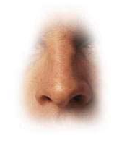
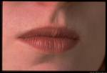
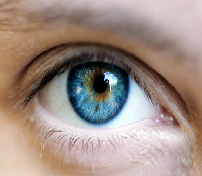

SENSES

Slide 2
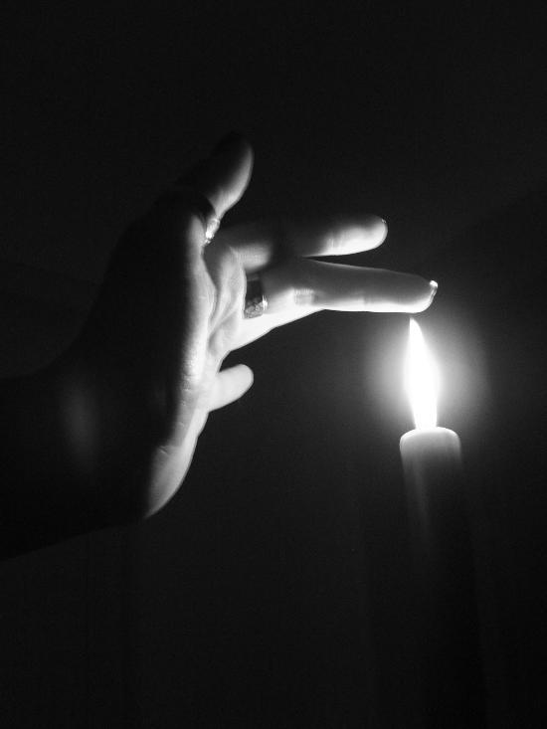
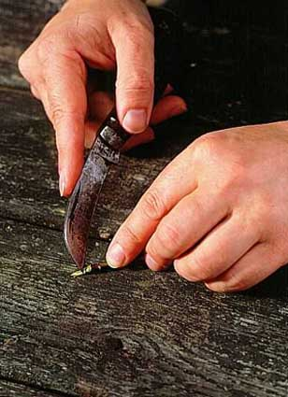

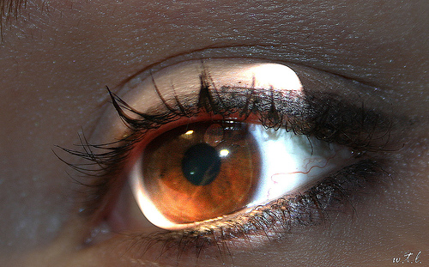
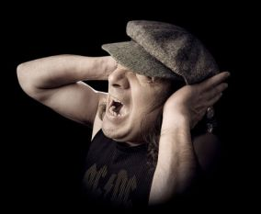
What would happen next?

Slide 3
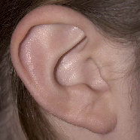
Nervous system
Parts of our body we use to sense things are called SENSE ORGANS – eye, ear, mouth, skin, nose.
Each SENSE ORGAN has special cells called RECEPTOR CELLS. Each receptor cell is sensitive to different things.

Slide 4
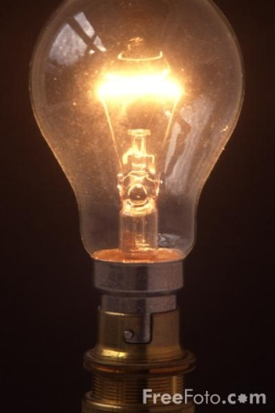

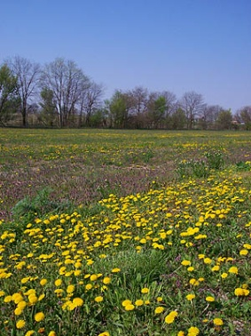
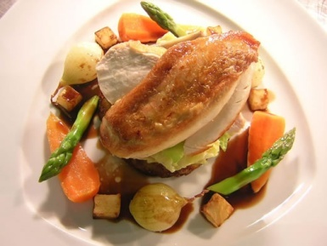
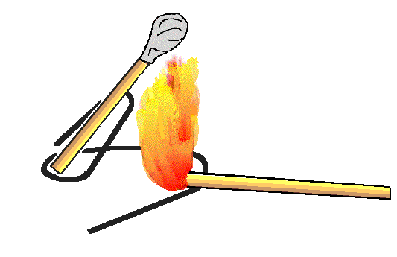
Senses
Receptors in eye sensitive to light
Receptors in ear and sensitive to sound
Receptors on tongue and sensitive to chemicals
Receptors in nose and sensitive to chemicals
Receptors in the skin and sensitive to touch, pressure, pain, temperature

Slide 5
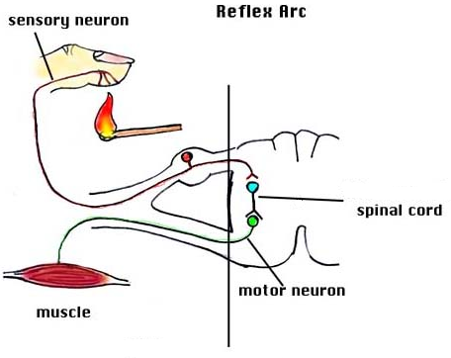
1.

Slide 6
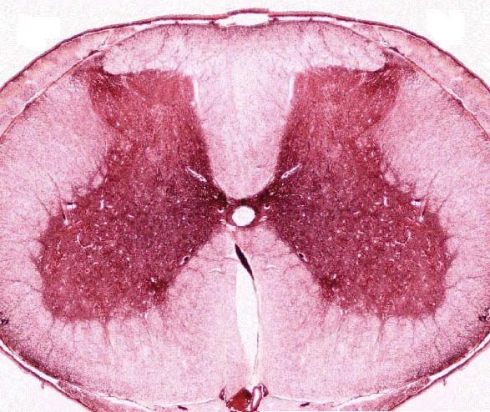
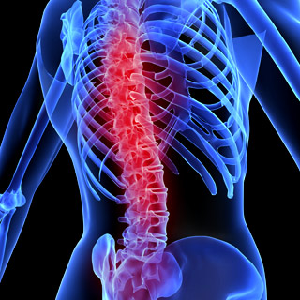
Main part of our nervous system is called the Central Nervous system
Spinal cord cross section

Slide 7
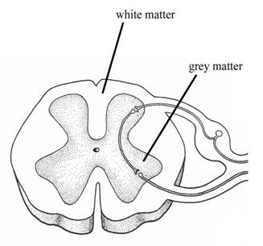
Spinal Cord

Slide 8
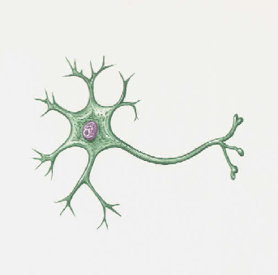
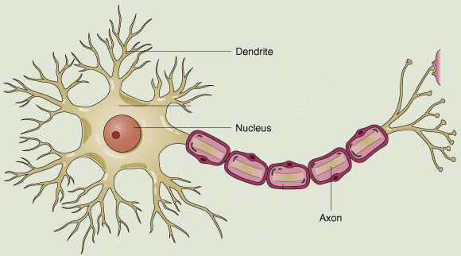
Let me introduce you to my friends!
Mrs. Sensory nerve
Mr. Motor Nerve
Nerve cell family are like messengers
They carry electrical impulses to and from the sensory organ (eye) and the spinal cord.

Slide 9
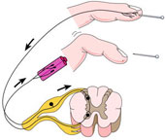
Reflex in the finger
Stimulus picked up by Receptor cells in finger (skin)
Impulse passed on to sensory neurone
Sensory neurone passes impulse to spinal cord
Spinal cord sorts out response and send message to motor neurone
Motor neurone tells the finger to pull away

Slide 10
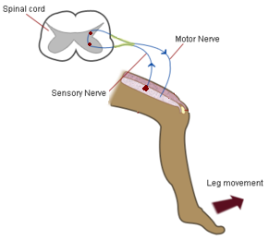
Reflex in the leg
Stimulus picked up by Receptor cells in leg (skin)
Impulse passed on to sensory neurone
Sensory neurone passes impulse to spinal cord
Spinal cord sorts out response and send message to motor neurone
Motor neurone tells the leg to move

Slide 11
Match up sense organ to stimuli

Slide 12

What have we leant today?
Sense organs in the body are eye, tongue, ear, skin and nose
Sense organs have receptor cells which respond to specific stimuli
Nerve cells relay information (messengers) as electrical impulses
Brain or CNS make the decisions!

Slide 13
Stimulus (change) picked up by receptor
Impulse carried along nerve cell (Sensory neurone) to spinal cord
Spinal cord or brain sorts out message
Impulse carried along nerve cell (motor neurone) to effector organ
Effector organ brings about a response

Slide 16
What did we do last lesson??
Reflex Arc
Sense ____ in the body are eye, tongue, ear, skin and nose
Sense organs have receptor cells which respond to specific _______
Nerve cells relay information (messengers) as ____________ impulses
CNS –________________make the decisions!
Central Nervous System, electrical, organs, stimuli

Slide 17
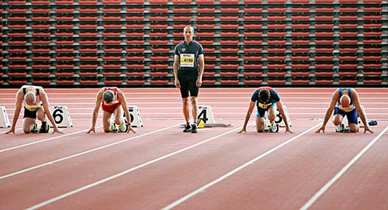
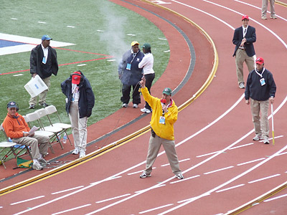
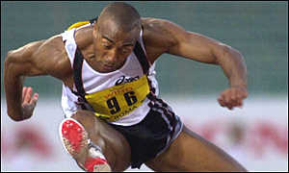
Why is good reflex important?

Slide 18
Learning objectives
By the end of the lesson you will…
Be able to test and measure your own reflexes
Be able to record and display your results

Slide 19
How fast are your reflexes??
How can we measure our reflexes?
Practical experiment….Using a ruler
1.Using a ruler you have to see how quickly you can catch it.
2. Each person will try three times and record their results in a table
3. We will then collect the class data and find out who has the fastest reflexes!!!

Slide 20
Results
Name | Result 1 | Result 2 | Result 3 | Average
NOTE : To work out the average you add all the result up, then divide by three…….EASY!!

Slide 21
Who is the fastest - Class results
Name | Average reflex (cm)
Liz
Becky
Jon
Liam
Lewis
Mat
Sophie
How else can we display our results?
Graph
Remember Title,
label axis,
0

Slide 22
Learning objectives
Know you can….
Test and measure your own reflexes
And record and display your results
WELL DONE 11E

Slide 23
Name | Result 1 | Result 2 | Result 3 | Average
Name | Result 1 | Result 2 | Result 3 | Average
Name | Result 1 | Result 2 | Result 3 | Average
Name | Result 1 | Result 2 | Result 3 | Average

Slide 24
Title
Title
Label Axis
Label Axis

